Slide 1
Public Group Meeting (8/13/24)
Somdeepa Das

Slide 2
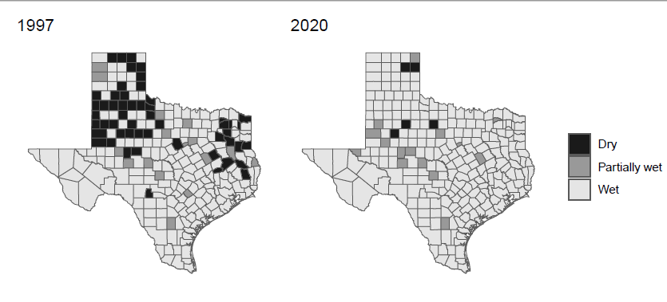
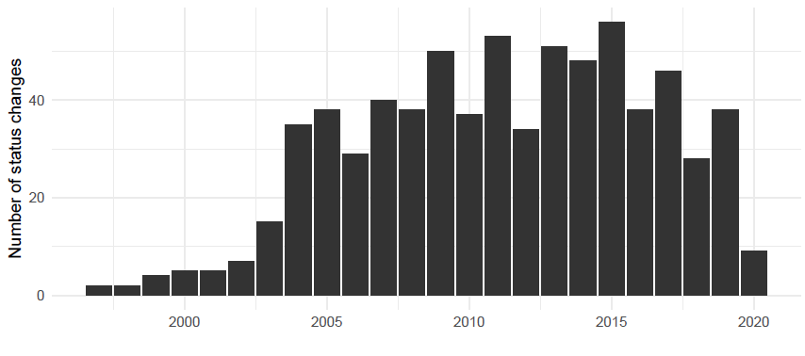
Local Option Elections in Texas- Summary

Slide 3
Election issues

Slide 4
Liquor licenses in Texas

Slide 5
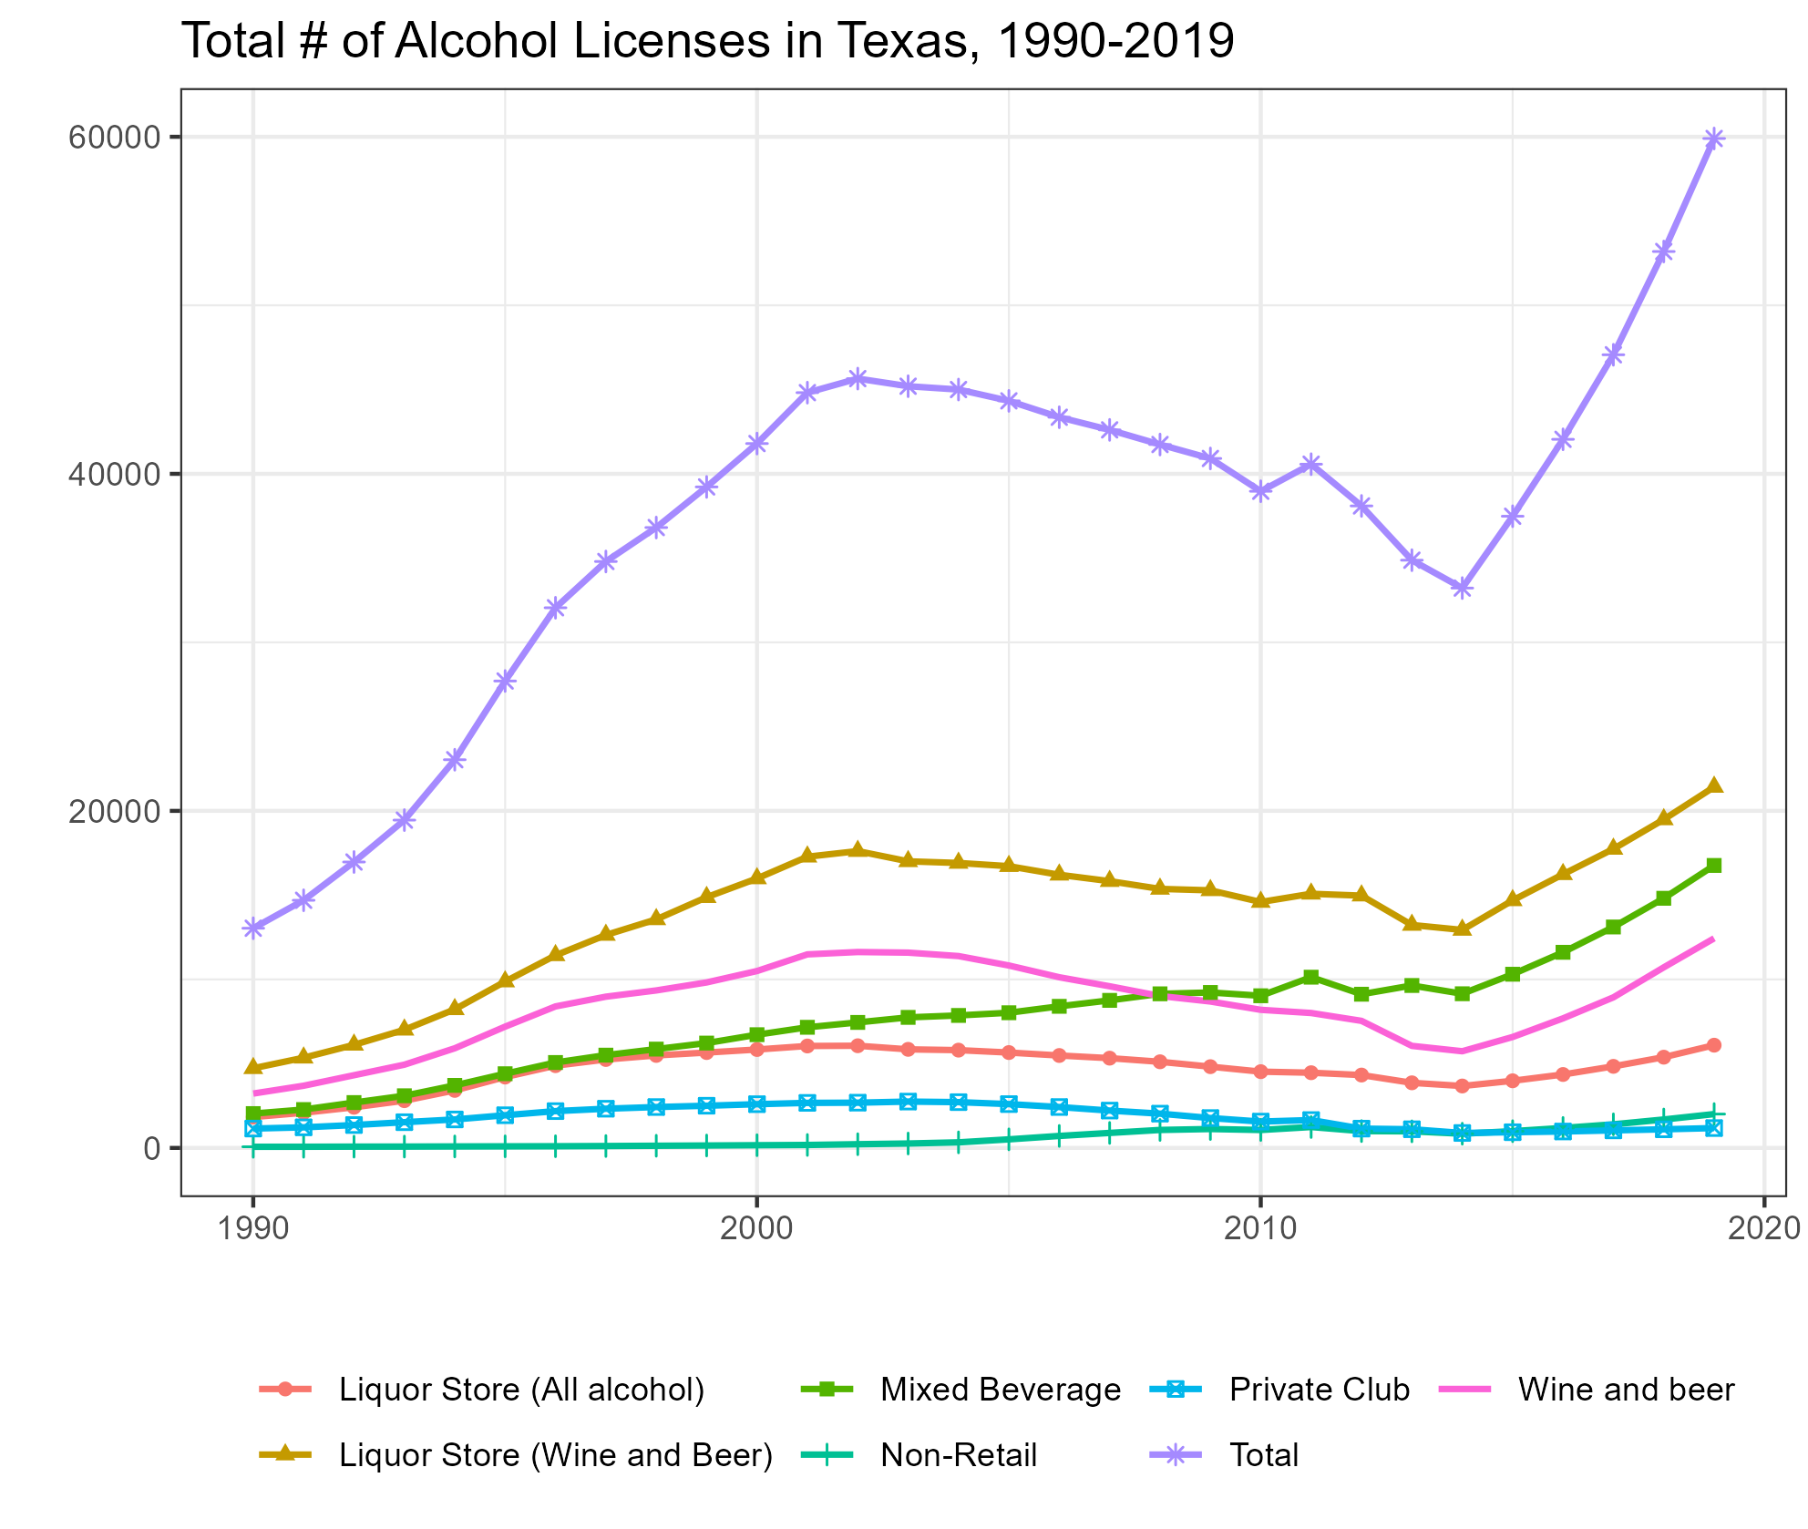
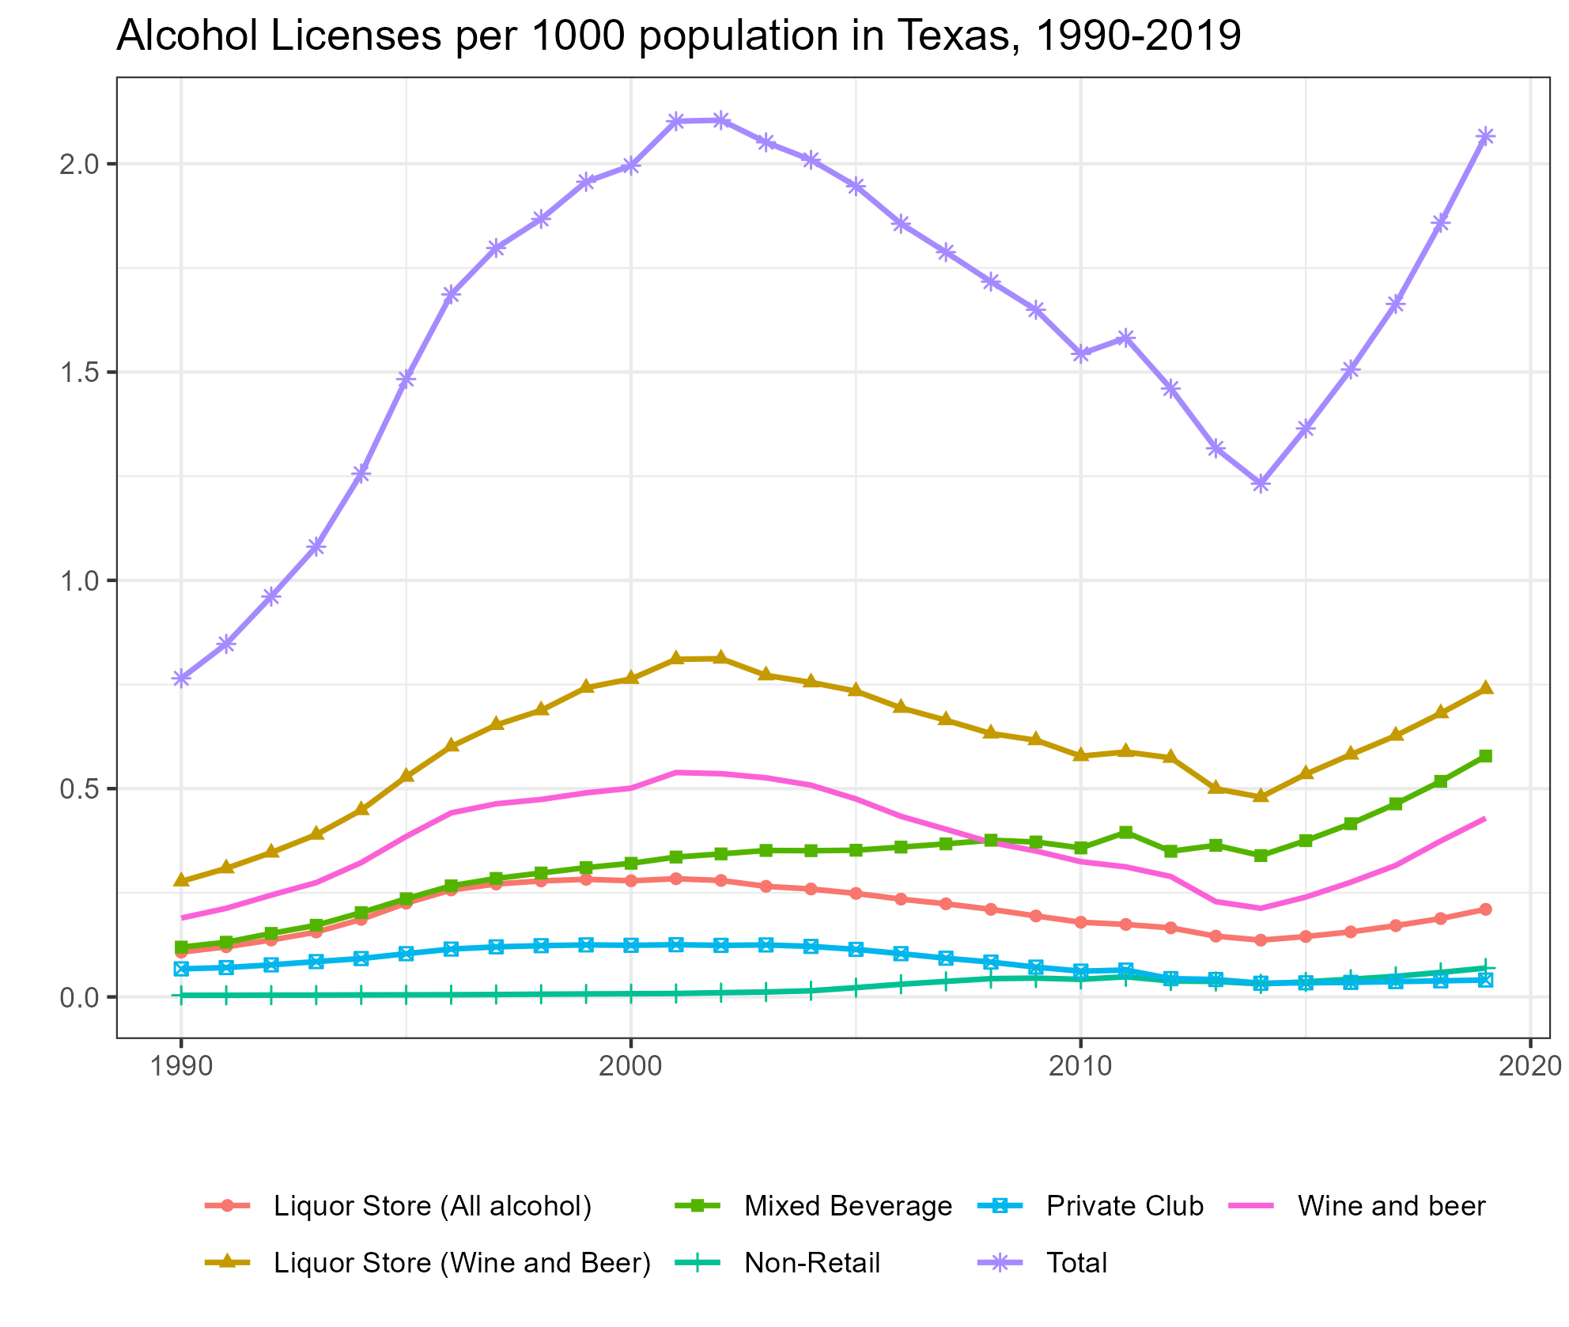
Liquor Licenses in Texas-Trends

Slide 6
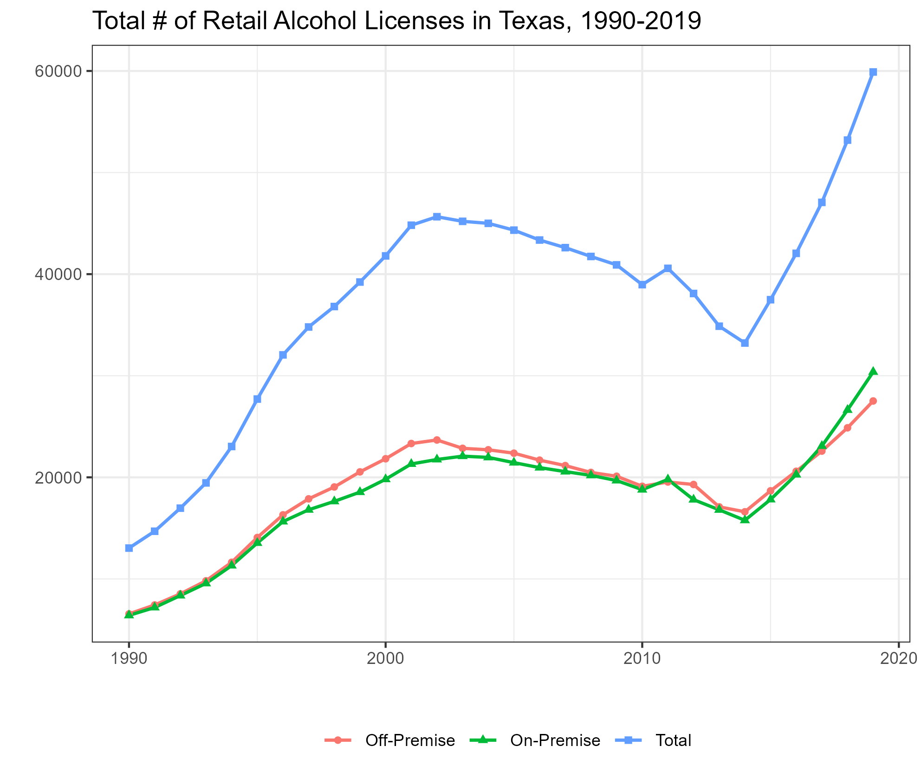
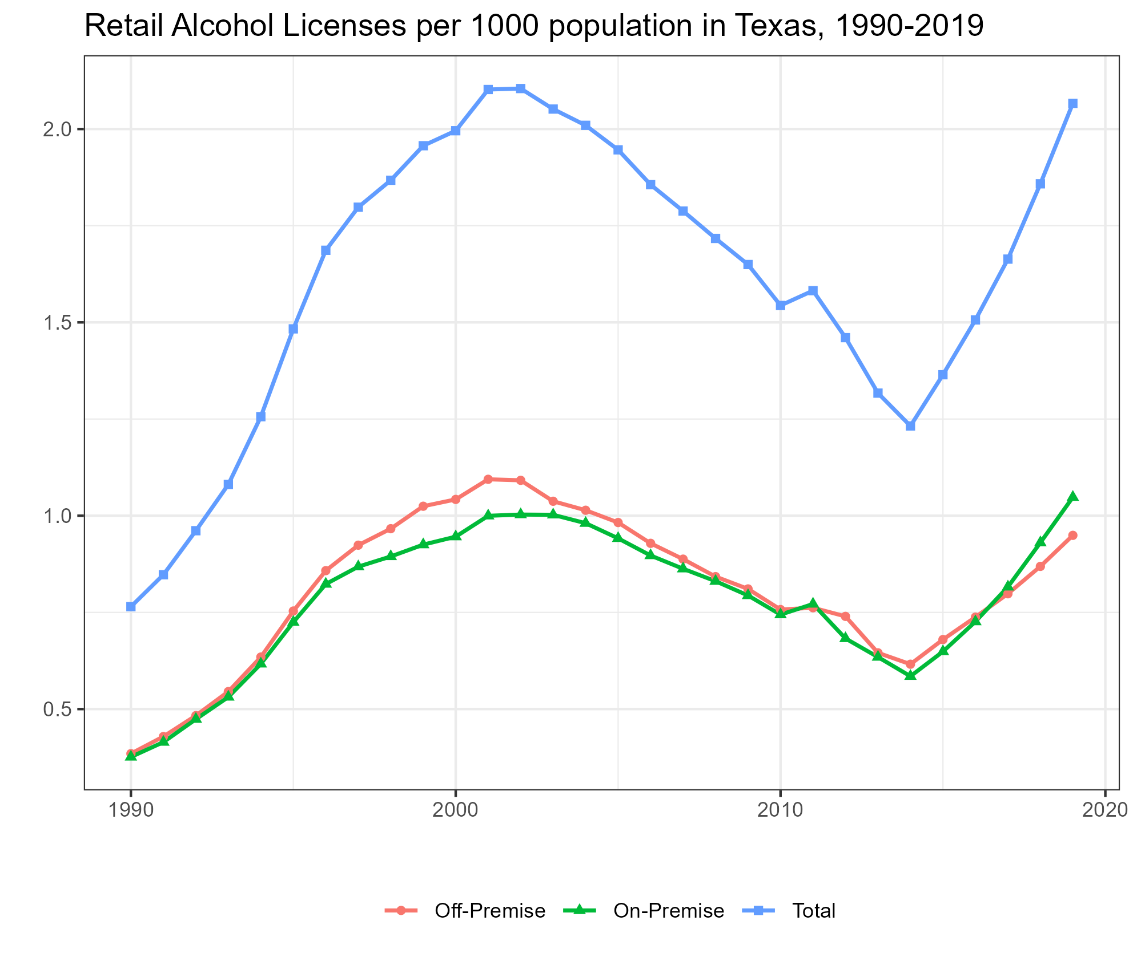
Liquor Licenses – Retail Trends

Slide 7
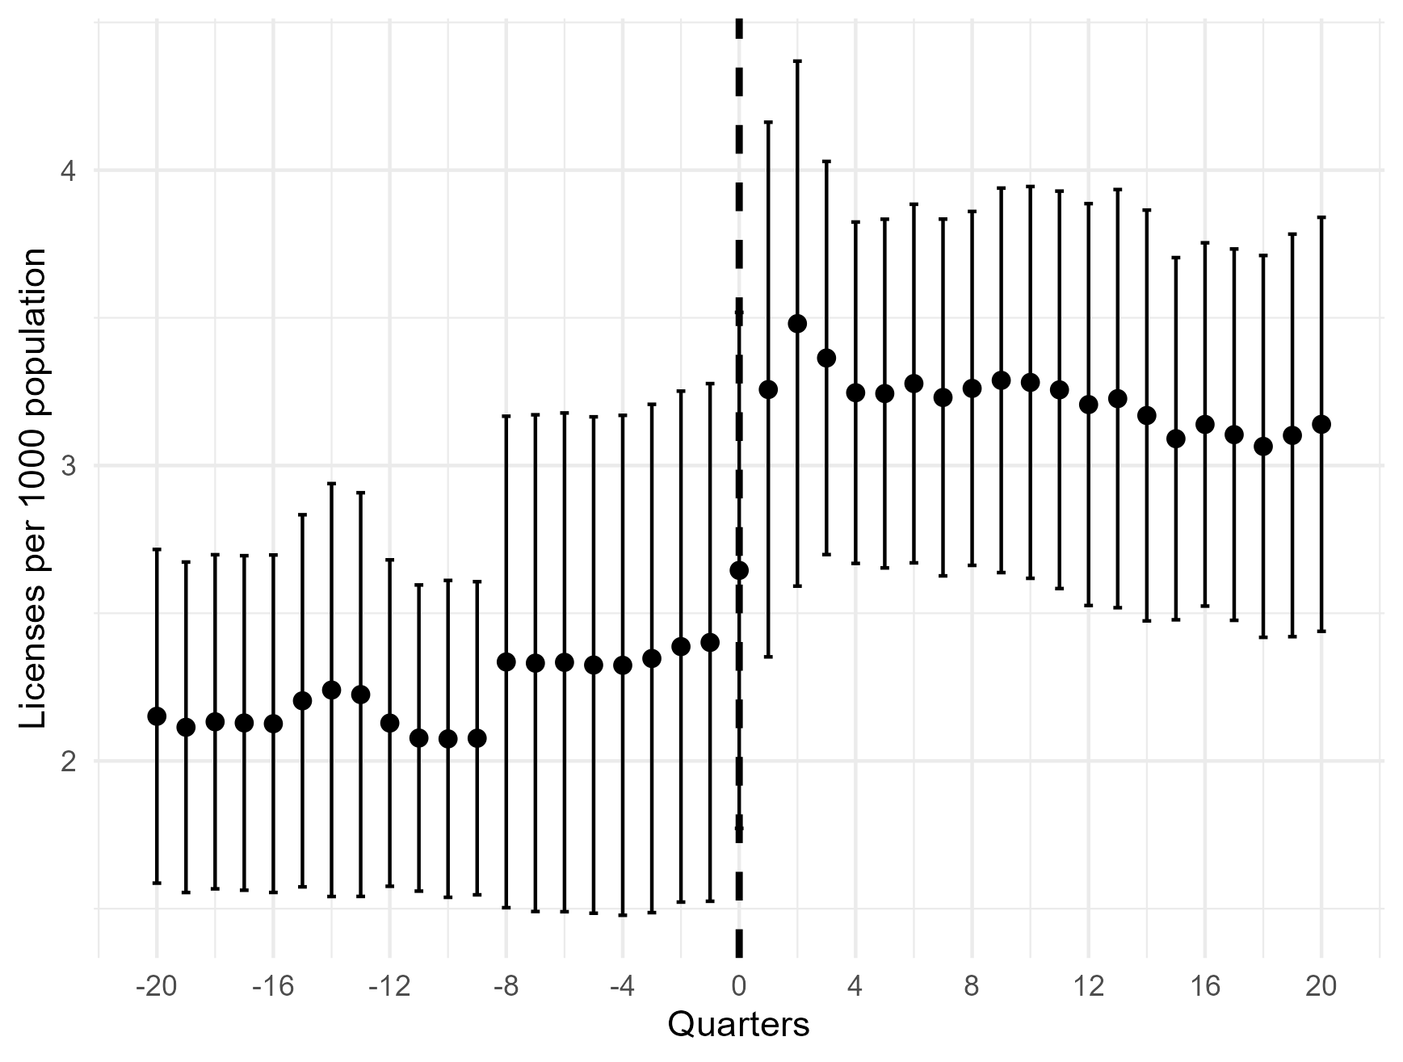
Licenses per 1000 population –Raw Data

Slide 8
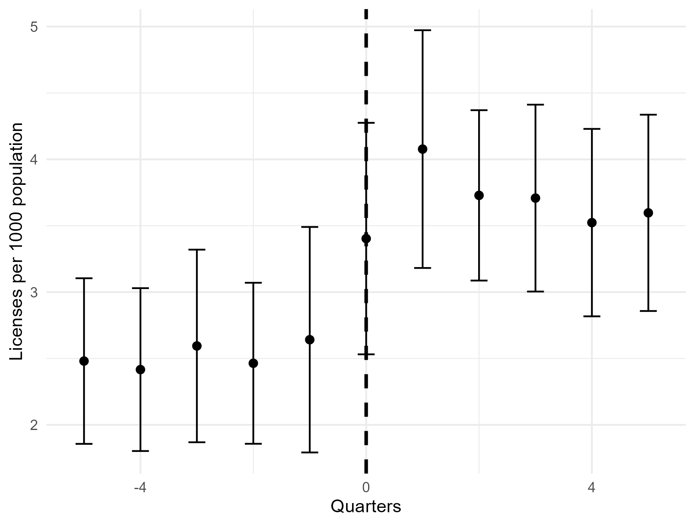
Licenses per 1000 population –Raw Data

Slide 9
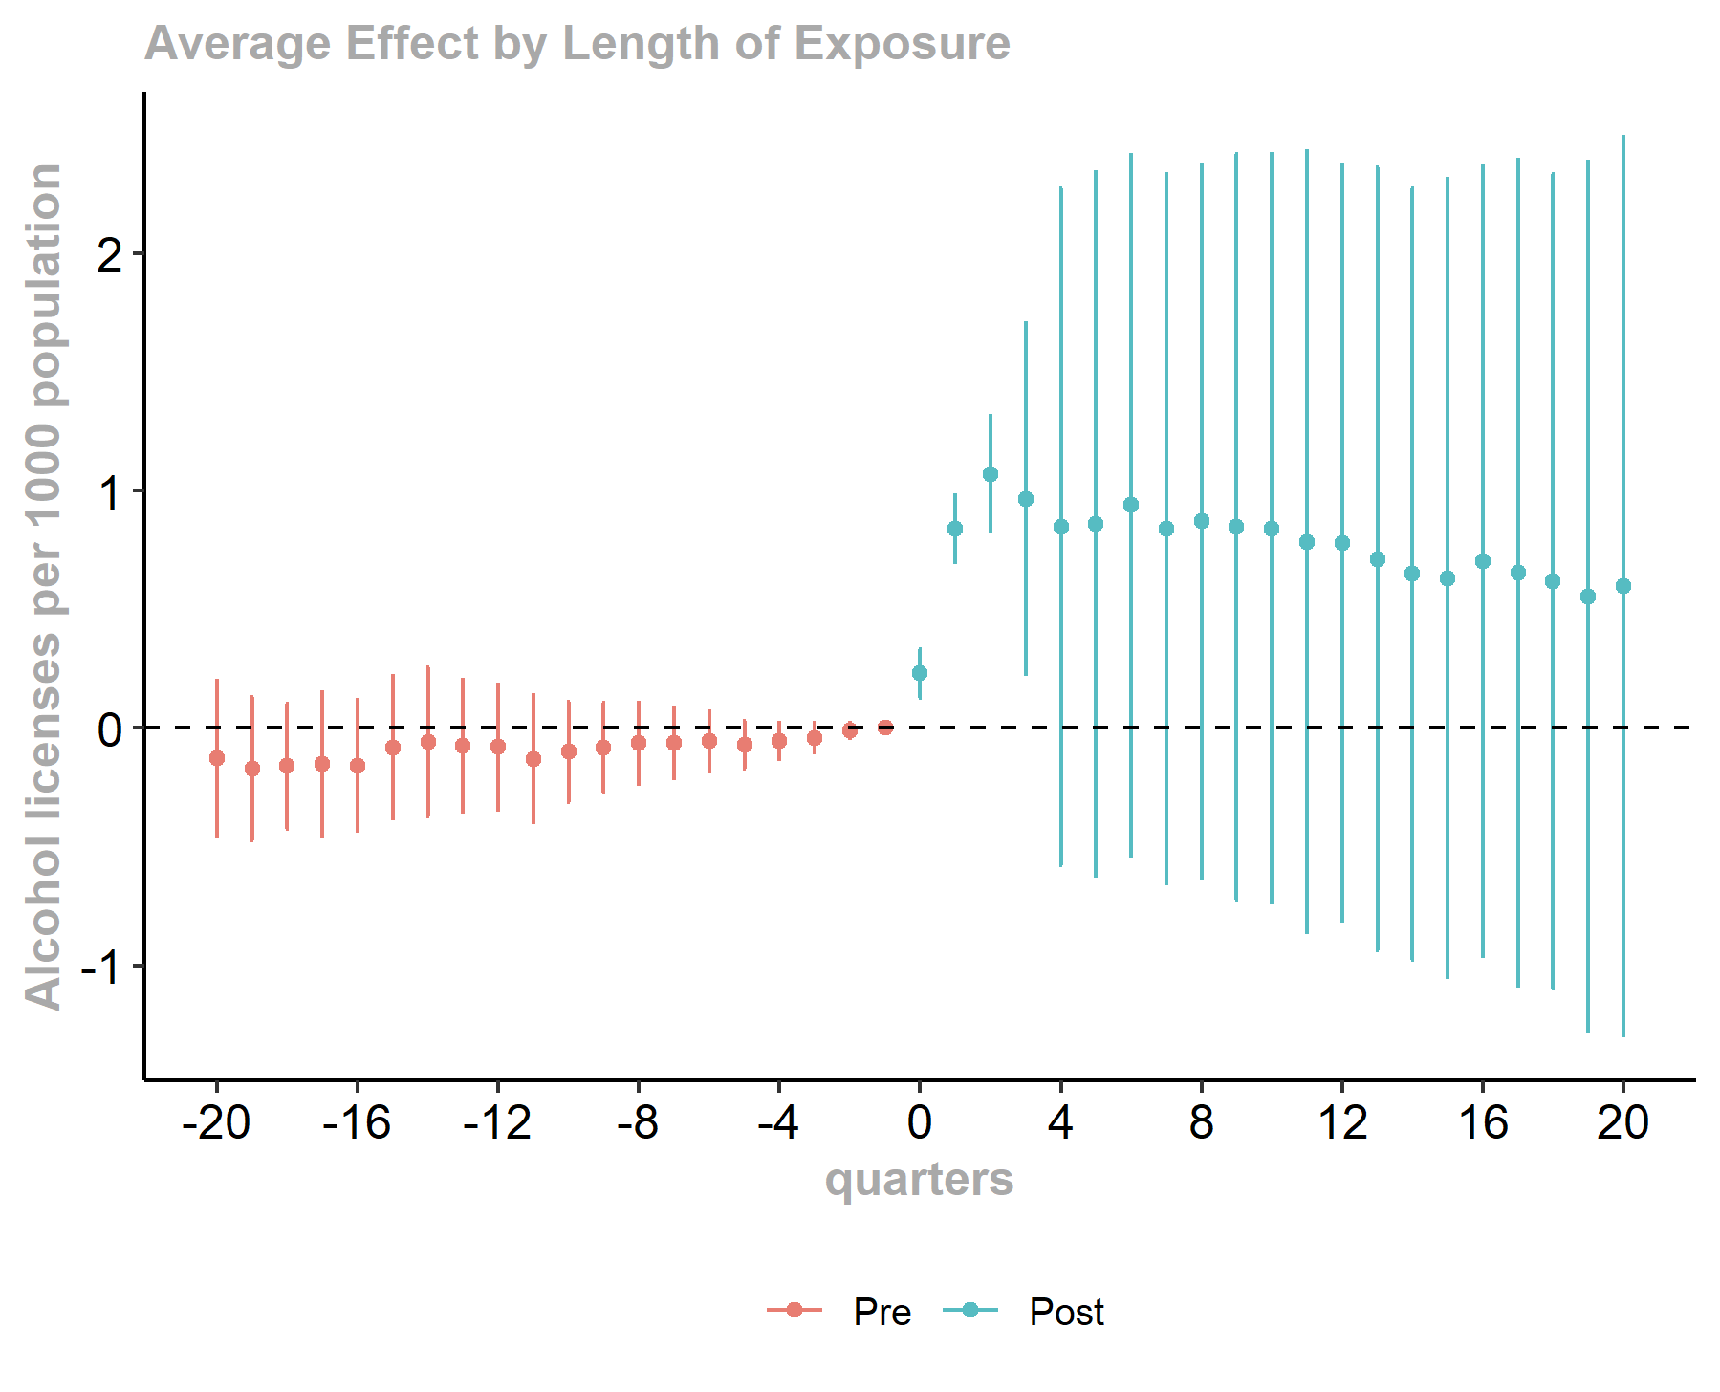
Licenses per 1000 population – Event Study

Slide 10
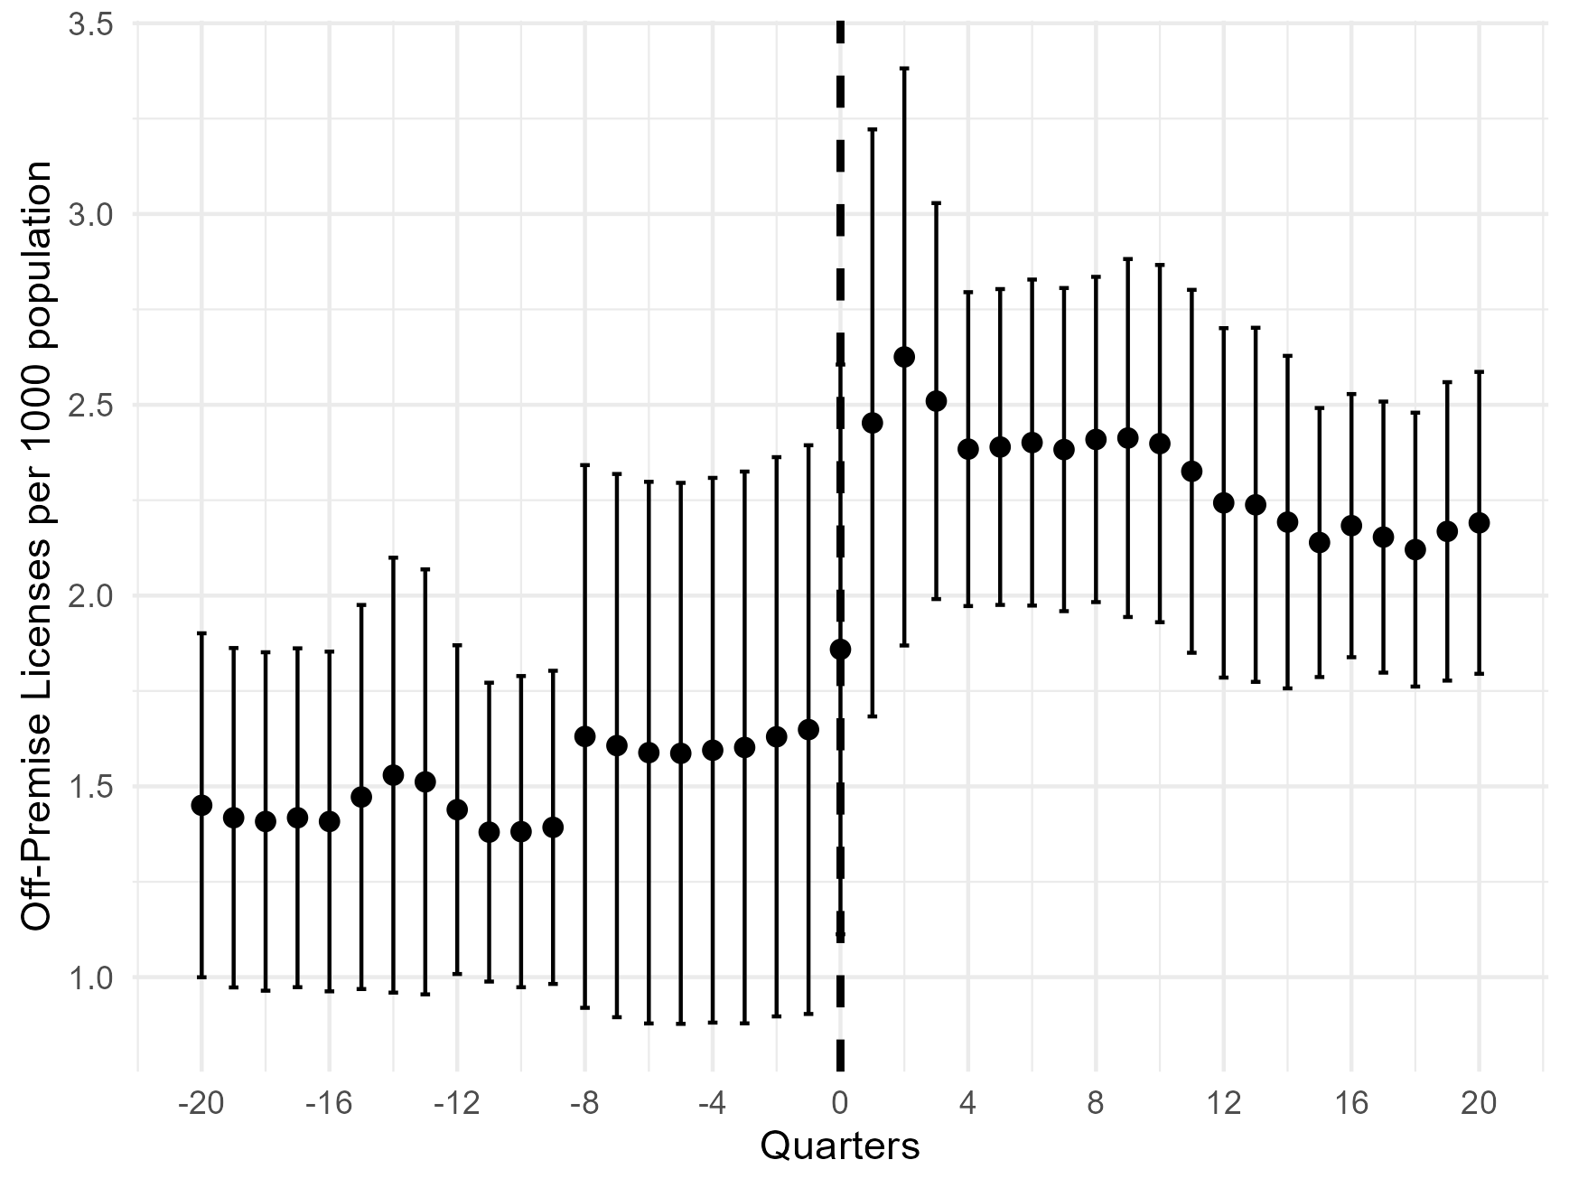
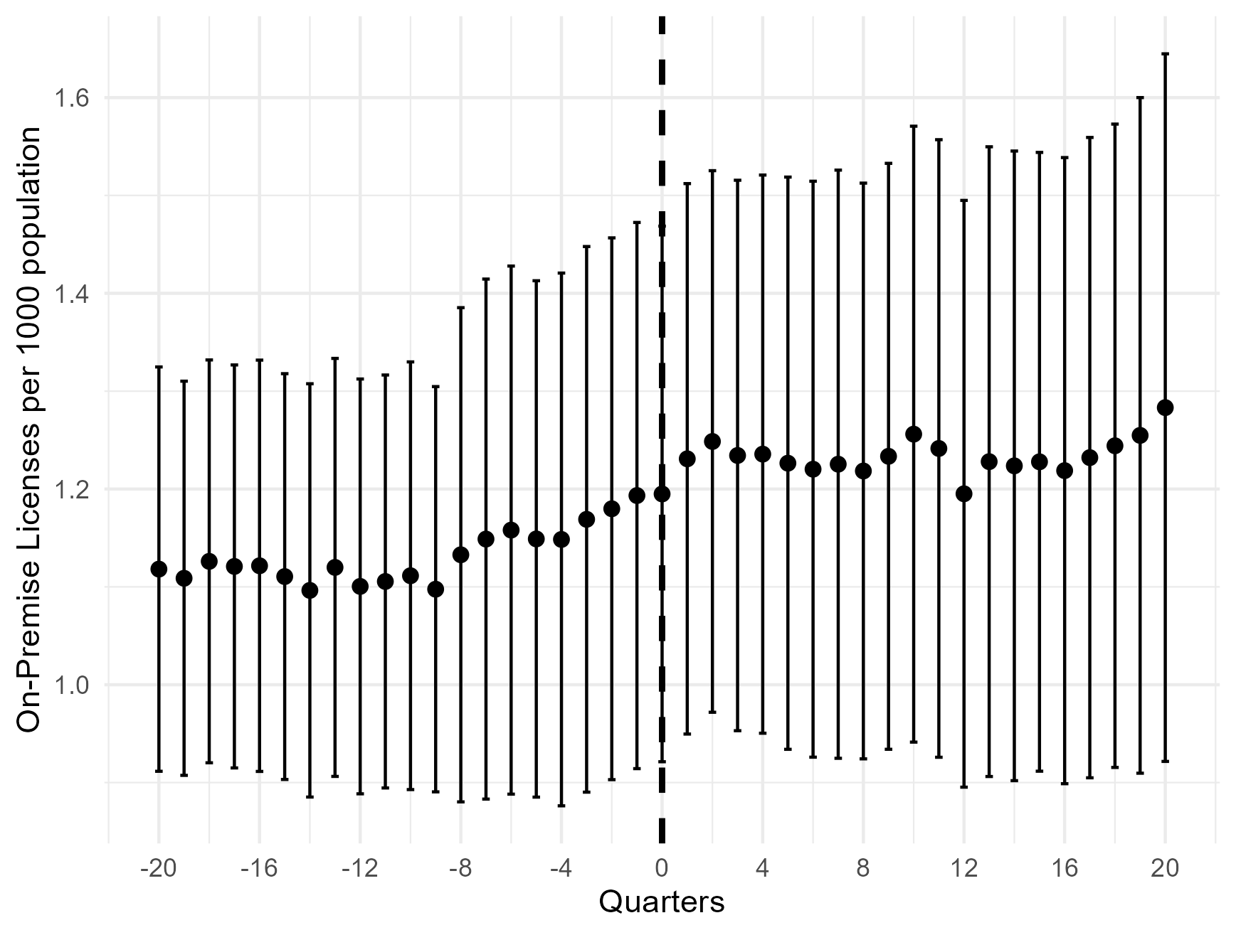
Off-Premise vs On-premise (raw data)

Slide 11
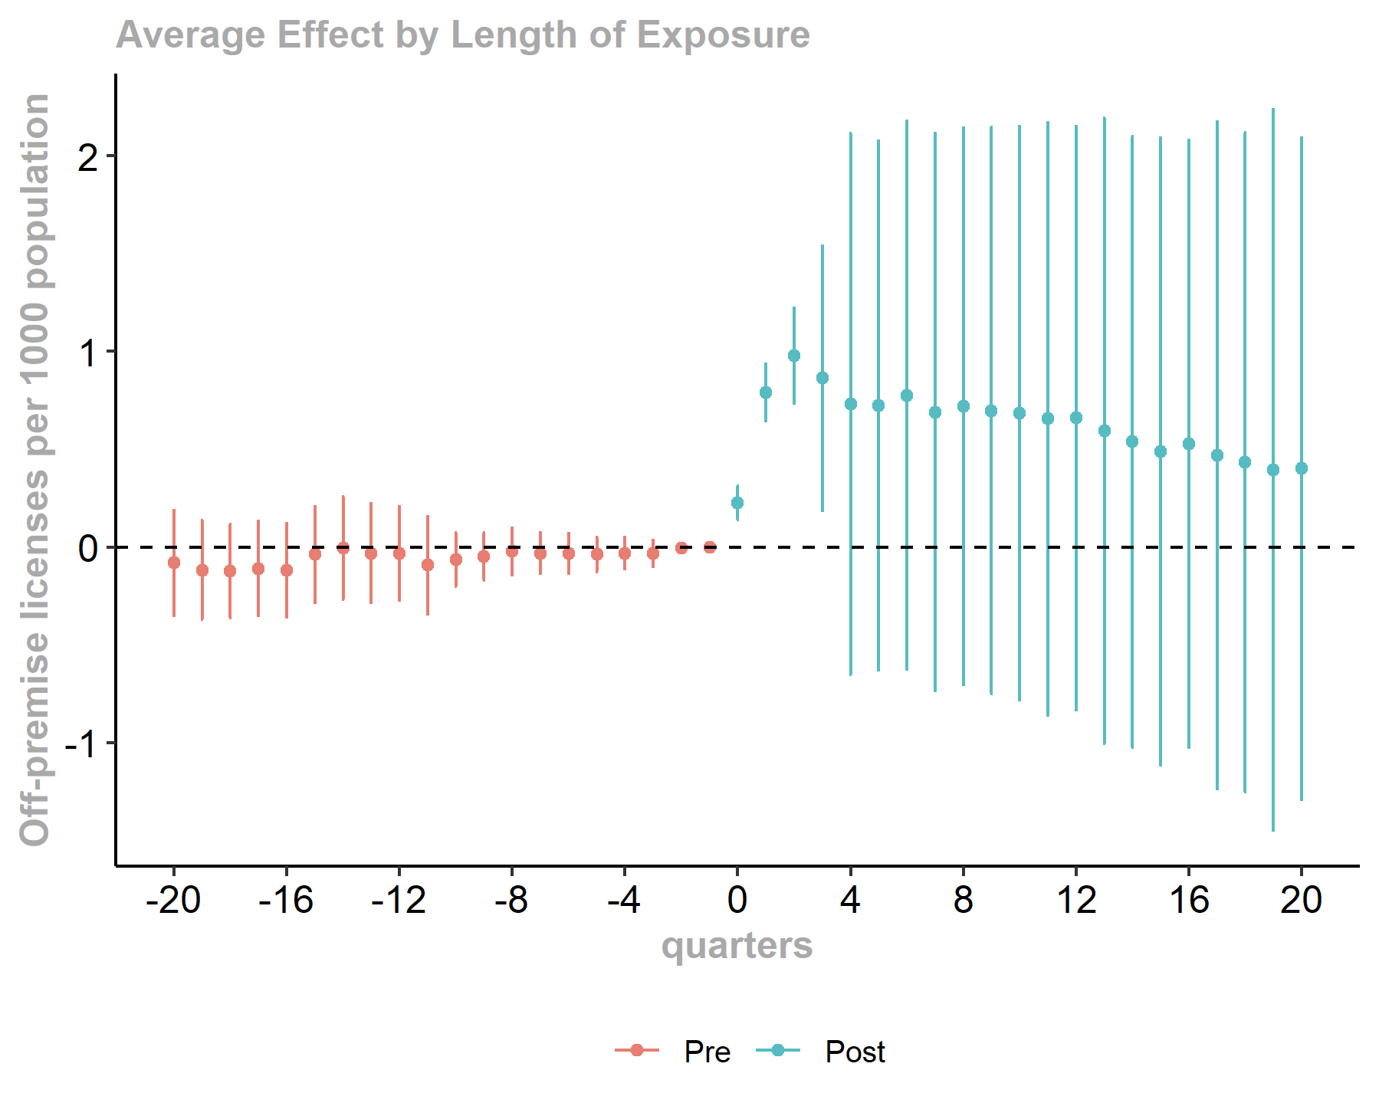
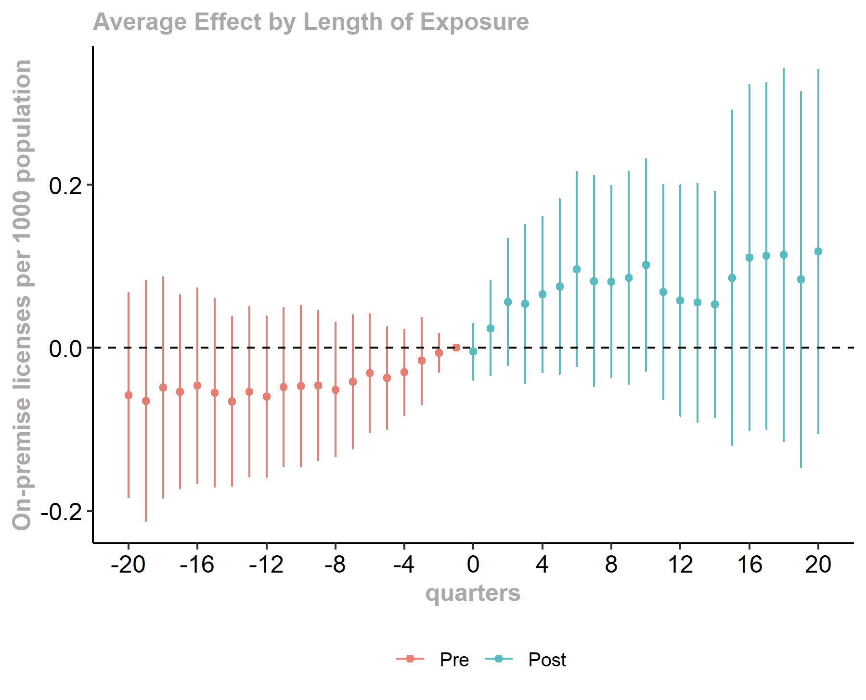
Off-premise vs on-premise

Slide 13
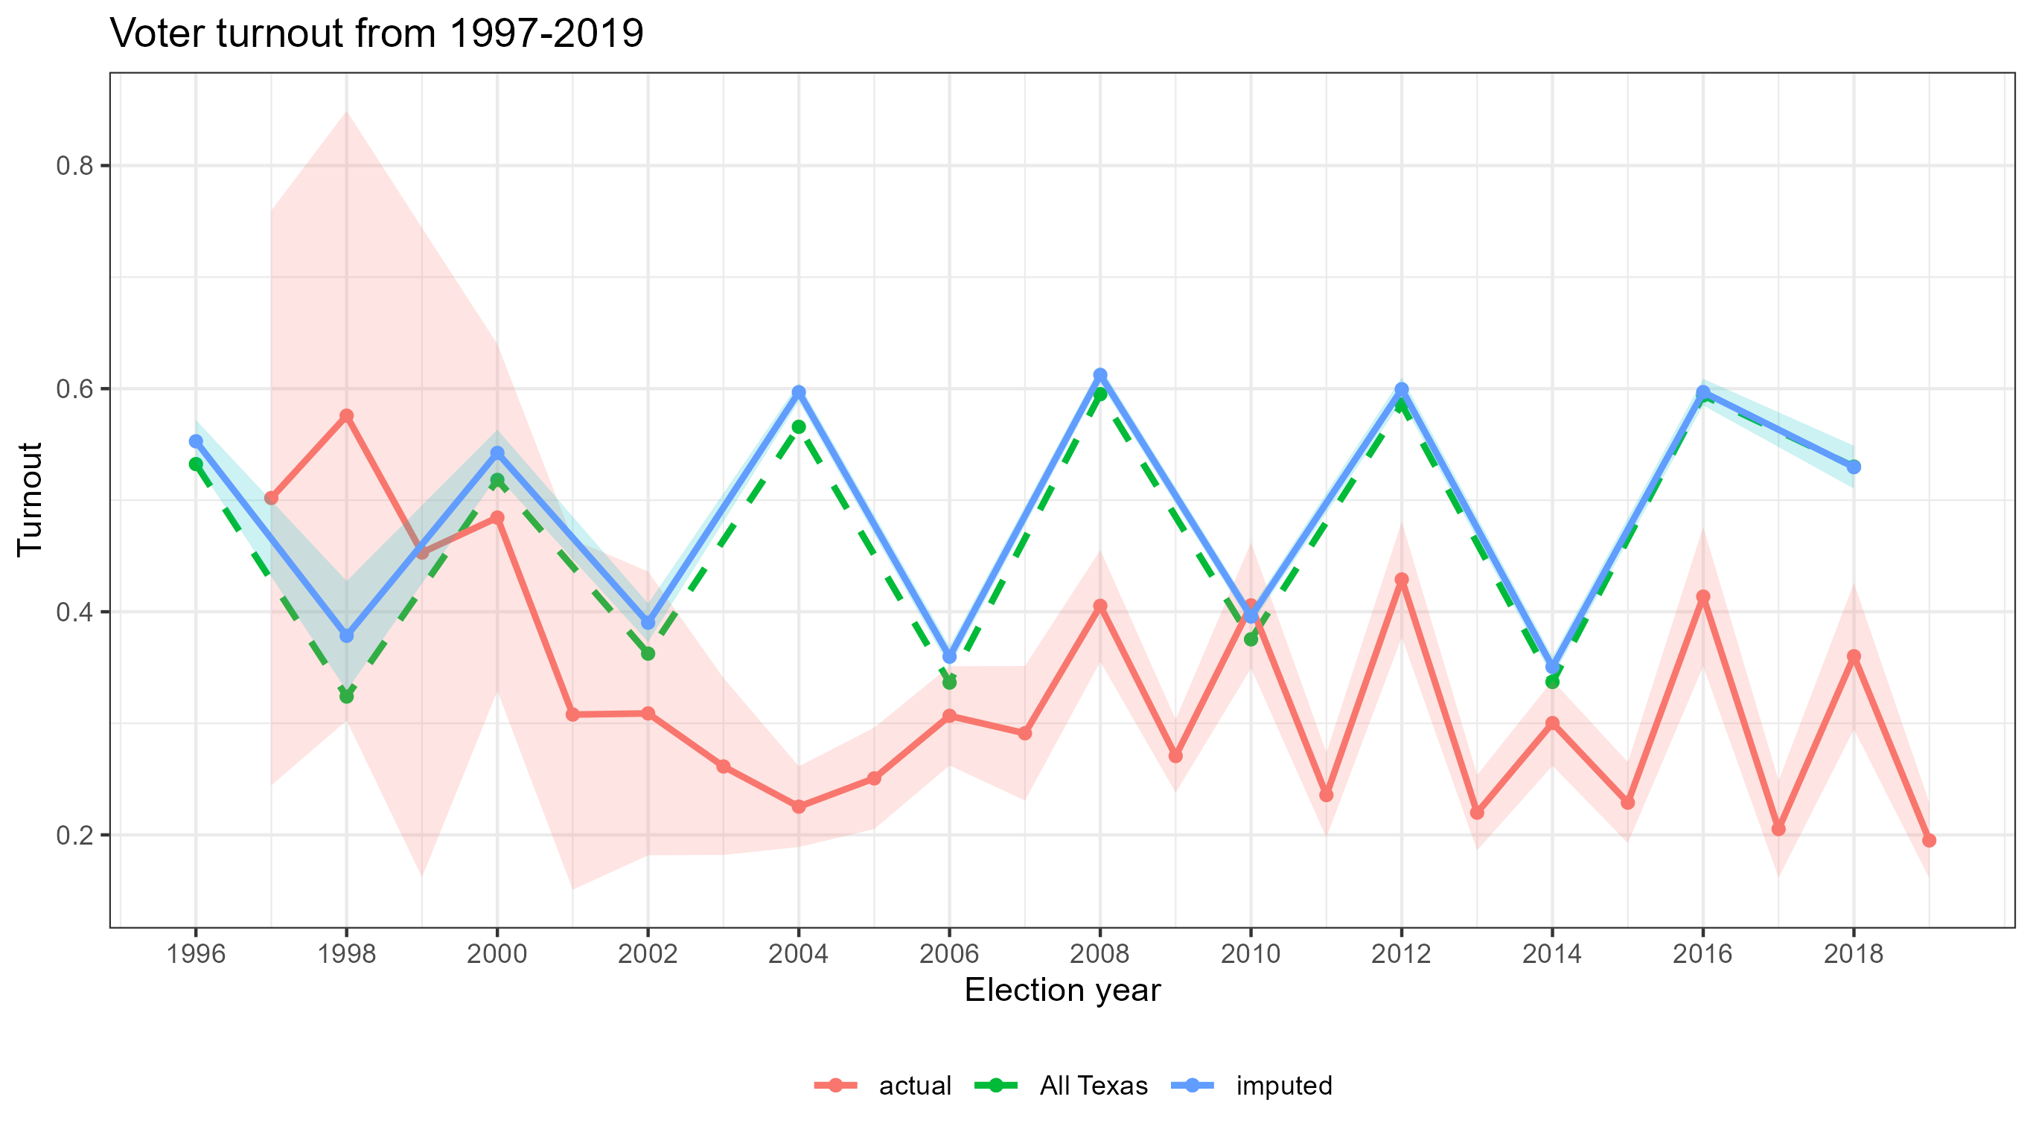
Election Turnout

